Slide 1
Enterprise Application Integration
Litsietsi Montsi

Slide 2
Pre-lesson exercise
Login on Facebook using the machine you are occupying.
Go to https://developers.facebook.com and sign up as a Facebook developer.
Create an application: this will be similar to Facebook applications that you have seen on Facebook.
Click on tools -> Graph API explorer.
Click on submit!

Slide 3
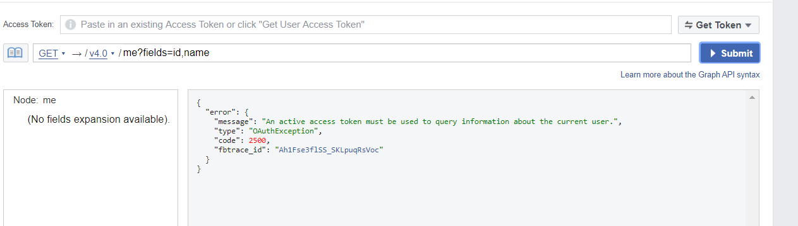
Pre-lesson exercise
You should see the following error message

Slide 4
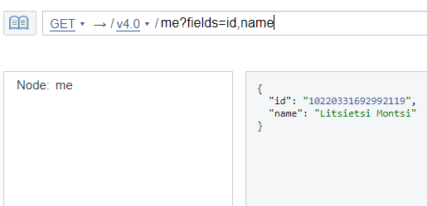
Pre-lesson exercise
Click on get token -> get user access token -> get token
Grant your application access and click submit.

Slide 5
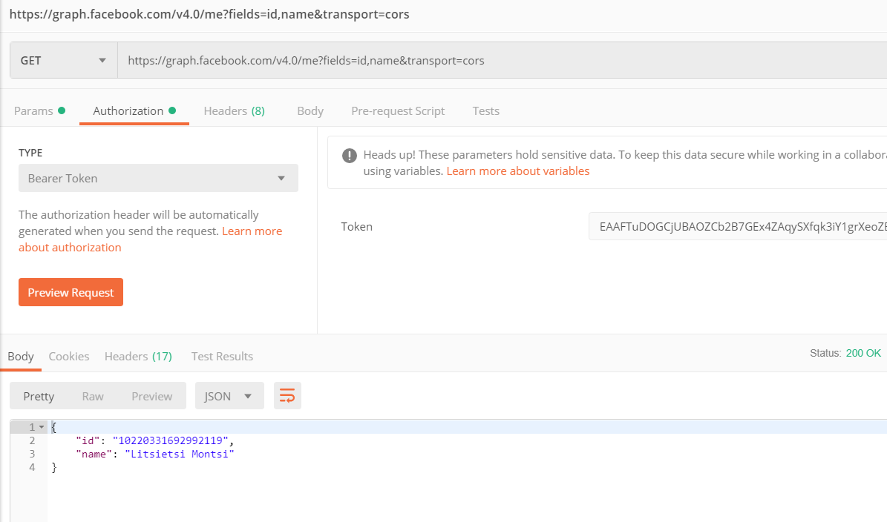
Pre-lesson exercise
The full path to the API is :
https://graph.facebook.com/v4.0/me?fields=id,name&transport=cors
You can even use “post man” to query this API

Slide 6
Pre-lesson exercise
You have just used the Facebook graph API
This is based on the REST webservice
All the Facebook applications you have seen, integrate with Facebook users this way.
An API, which mean Application Programming Interface is a set of libraries that deliver functionality or services to a client.

Slide 7
Contents
Background
Integration strategies
Shared database
Message queues
Webservices
Client library API

Slide 8
Background
Application integration is the process of enabling independently designed applications to work together. Commonly required capabilities include:
Keeping separate copies of data (in independently designed applications) consistent
Orchestrating the integrated flow of multiple activities performed by disparate applications
Providing access to data and functionality from independently designed applications through what appears to be a single user interface or application service

Slide 9
Integration strategies
These are mechanisms/ways employed to achieve integration between two or more systems depending on the use case at hand.
In the course, we will cover the following strategies:
Shared database
Web-services
Message queues
Client Library API

Slide 10
Shared database
This is where applications share a data-store and communication is done by reading and updating records in this data-store.
Application A
Database
Application B

Slide 11
Shared database
This method is still predominantly used in industry.
However, it goes against best practices and Layering, why?

Slide 12
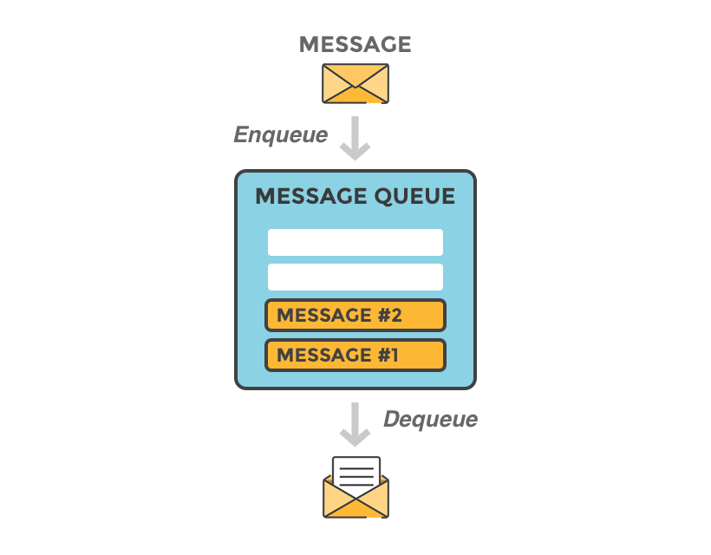
Message queues
A computer science concept that originates from algorithms and data structures.
These provide asynchronous communication between two systems.
Situations where one might consider using a message queue:
These are used for reliable delivery of messages.
These are used for real-time communication.
Information distribution like app notifications.

Slide 13
Message Queues
Point to Point (Queueing) | Publish subscribe
Queue | Tuple
Sender | Publisher
Receiver | Subscriber
A message queue can operate in different modes or integration patterns:
Point to point
Publish subscribe
Both these patterns introduce different terms.

Slide 14
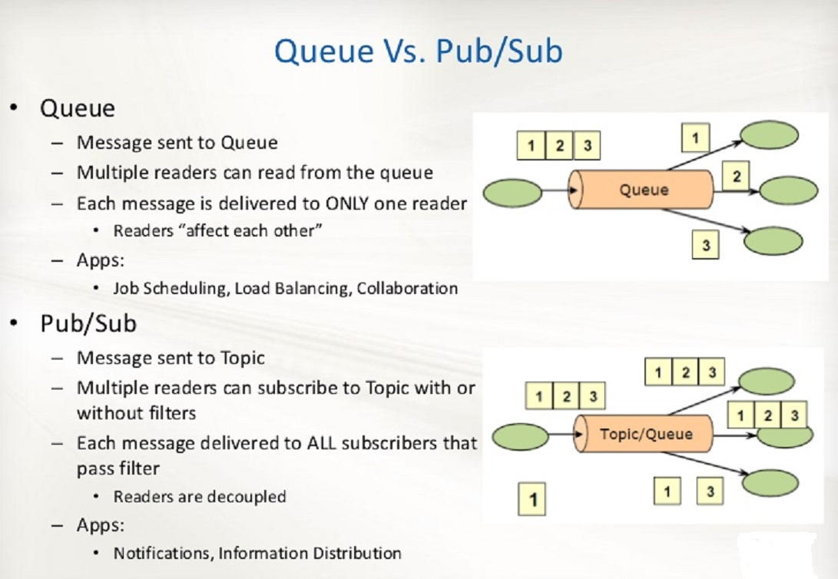
Message Queues

Slide 15
Message queues
Java Uses the Java Message Service API to integrate with message queues.
Examples of message queues:
Java EE message queues (JMS)
Tibco queues
Active MQ
General message queues
Rabbit MQ

Slide 16
Web Services
ISO/IEC 17963:2013 Web Services for Management (WS-Management) Specification describes
“ISO/IEC 17963:2013 describes a Web services protocol based on SOAP for use in management‑specific domains. These domains include the management of entities such as PCs, servers, devices, Web services and other applications manageable entities. Services can expose only a WS-Management interface or compose the WS-Management service interface with some of the many other Web service specifications.”

Slide 17
Types of common Webservices
Simple Object Access Protocol (SOAP)
REpresentational state Transfer (REST)
Attribute | Simple Object Access Protocol (SOAP) | REpresentational state Transfer (REST)
Types | Document Style and RPC style | Loose free type
Java EE interfaces | Jax-ws | Jax-rs
Java EE implementations | Apache CXF and Apache Axis | Rest Easy and Jersey
Exchange | XML only | Can take on many forms and mime types

Slide 18
SOAP
Simple Object Access Protocol
SOAP is an acronym for Simple Object Access Protocol. It is an XML-based messaging protocol for exchanging information among computers. SOAP is an application of the XML specification.
Although SOAP can be used in a variety of messaging systems and can be delivered via a variety of transport protocols, the initial focus of SOAP is remote procedure calls transported via HTTP.
This introduces a tightly coupled services contract name a WSDL ->Web Services Description Language
The tight services contract and xml only message exchange language were motivation for a newer standard, called REST.

Slide 19
REST
REpresentational State Transfer
Server sends state/values of a requested object to the client.
Uses underlying architecture for the web.
Following four HTTP methods are commonly used in REST based architecture.
GET − Provides a read only access to a resource.
POST − Used to create a new resource.
DELETE − Used to remove a resource.
PUT − Used to update a existing resource or create a new resource.
Resources
https://www.javatpoint.com/jax-rs-tutorial
https://www.youtube.com/watch?v=BuYivu9ZjDw

Slide 20

Practical tutorial
Follow the following tutorial to get a practical understanding of REST in the context of this course.

Slide 21
Practical Assignment
This assignment will not be marked
Change the front-end of assignment 1 to use REST instead of an MVC front-end.
The system have a post employee which saves employee.
There should also be a get employees and employee with id, which gets a list of employees and an employee, respectively.

Slide 22

Twitter Integration Requirement
In the exam and assignments, students might ne required to integrate with twitter.
Students are therefore required to have:
twitter account
An API key and token
This may be required in the examination.
Students are required to use “Twitter4j” library with the above key and token.
https://www.baeldung.com/twitter4j
http://twitter4j.org/en/

